Slide 1
Dungeon Quest Software Engineering COMP 4110 University of Massachusetts Lowell Fall 2020
Team members:
Greg Kaplowitz, Wyatt LaRose, Derrick Lor, Alberto Chavez, Nicholas Miceli
Project Manager: Greg Kaplowitz
Customer: Elementary school teachers
Instructor: Dr. James Daly*
*Please direct all inquiries to the instructor.

Slide 2
Problem and Methodology
Low stakes quiz and study formats allow students to guess without consequence.
It can be hard for students to find incentive to seek the right answer if they know they won’t be graded.
The solution is to provide alternative ways to encourage students to try their best.
By incorporating the questions into a game, students will try their best because they want to win the game.
Notes:
Could compare things like quizzlet versus Kahoot. Both quiz students, but one does so in a way that is enjoyable and incentivizes finding the right answer. Greg.
"The problem is that kids don't want study, but they do enjoy playing games. Our solution combines the knowledge that kids need to learn with the entertainment of a game."

Slide 3
Domain Research
Mass Dept. of Education 6th grade standards:
Specifically, English, History, and Math topics.
What encourages younger students to try their best?
“[Provide] incentives to students that emulate the reward system associated with a gaming experience” [1].
Some argue games deter from learning, however the two are not mutually exclusive.
Notes:
Some argue that if learning is in a fun/game format then students aren’t really learning. In reality they are learning the same but the instant-gratification that comes with playing games is being used to encourage it and make it enjoyable. [Greg]
"A big part of the learning process is finding ways to test yourself . Using a game to test students will allow kids to find out whether or not they know the material and gives them a reason to want to learn it. The roguelike format that we chose makes it very replay *able which is important because students often need to continues test themselvs to know if they are learning the material and commit the answers to memory.

Slide 4
Technology
Unity
Unity Collaborate – Version Control
C#
JSON
Used to store questions to be displayed
Also used for storing game data (Players lives, Progress so far)
Microsoft Teams
Meetings and other communications
File sharing
Notes:
Quick overview, more in depth explanation on the next slide. Derrick

Slide 5
Architecture
JSON
Source of information (Questions, game data)
C# Scripts
Read/write JSON
Use information to control scenes
Unity Scenes
Display progression on maps
Allow user interaction with the questions
Notes:
Derrick

Slide 6
Overview of Features
Ability for users to select which dungeon to play
English, History, or Math
Also lets users select a path within the dungeon
Turn based encounters
Users need to answer correctly to defeat boss
Incorrect answer takes ~1/3 health from the user
Three incorrect answers takes one life (out of 10) from the user and exits them to the dungeon map
Score based on completion
One point out of ten for each successful encounter
Max score 10/10 per dungeon
Notes:
Wyatt

Slide 7

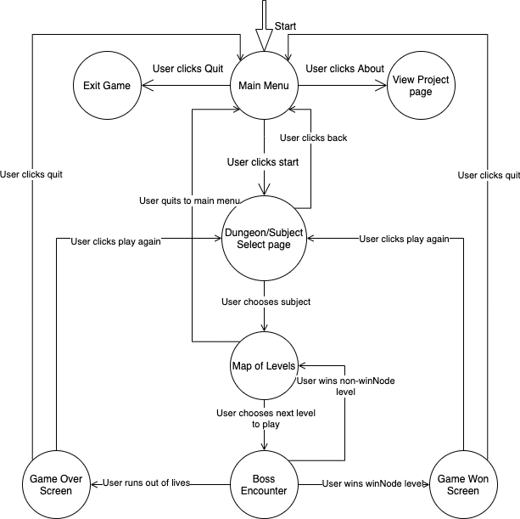
State Diagram
Notes:
Busy slide but I think this diagram does the best job describing the flow of the game. Would be useful to spend some time going through it before going into the demonstration/video. Wyatt.

Slide 8
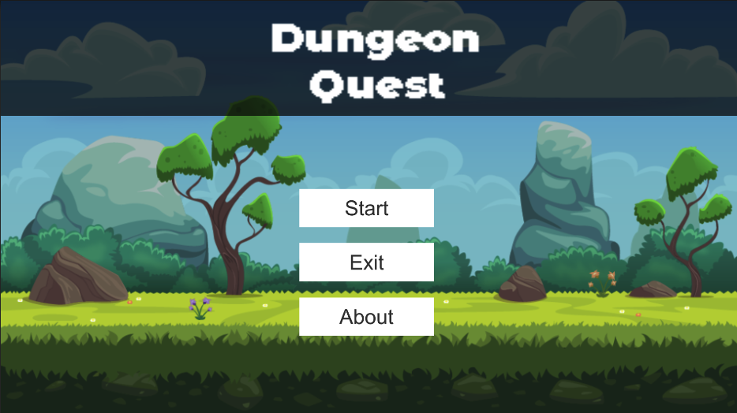
Main Menu
Notes:
Alberto

Slide 9
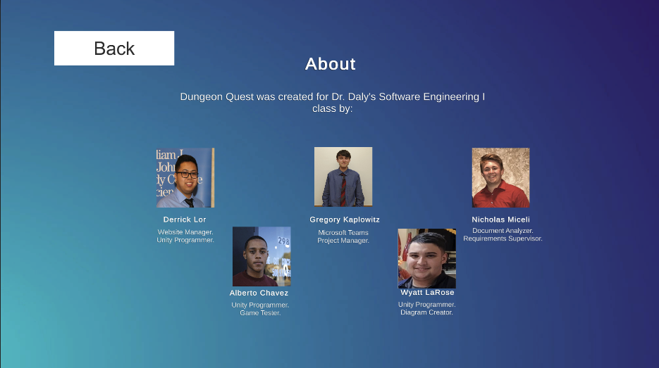
About page
Notes:
“Here is what’s displayed if the user navigates to the about page, displays our names and roles in development”

Slide 10
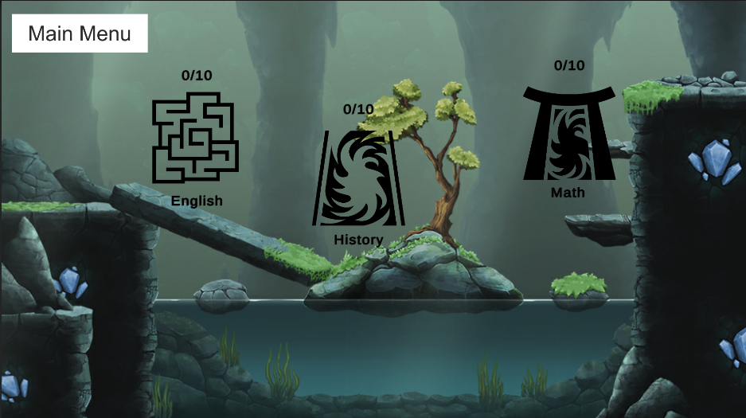
Dungeon Select
Notes:
If the user instead chooses start, they will be navigated to the dungeon select screen

Slide 11

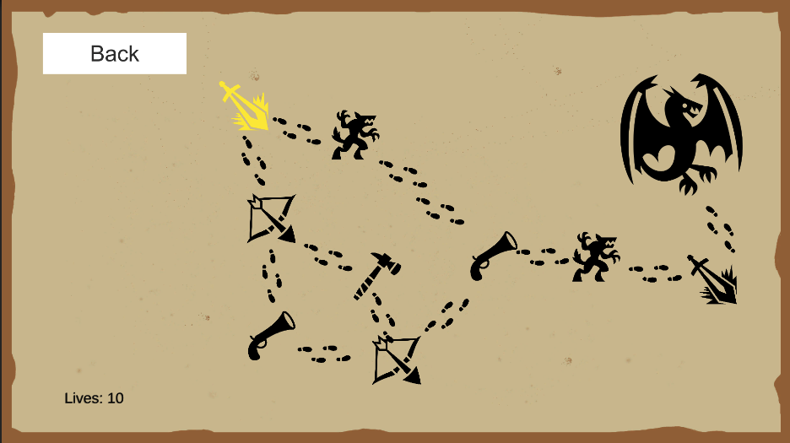
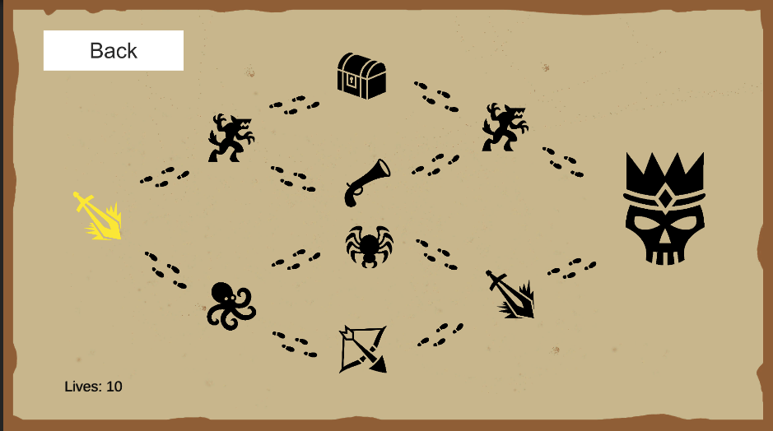
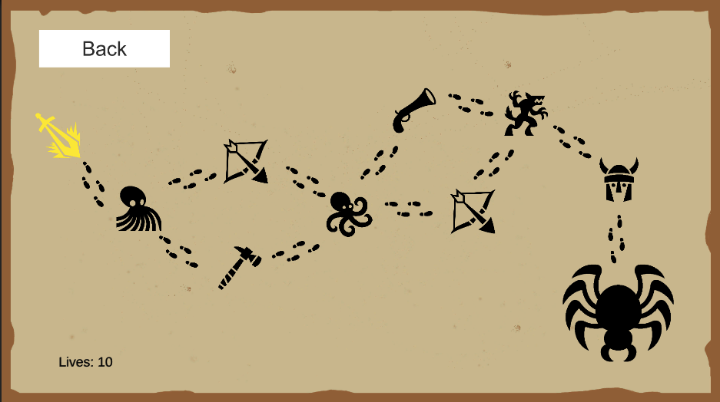
English Dungeon
History Dungeon
Math Dungeon
Notes:
Here you can see the three different dungeon designs for each subject

Slide 12
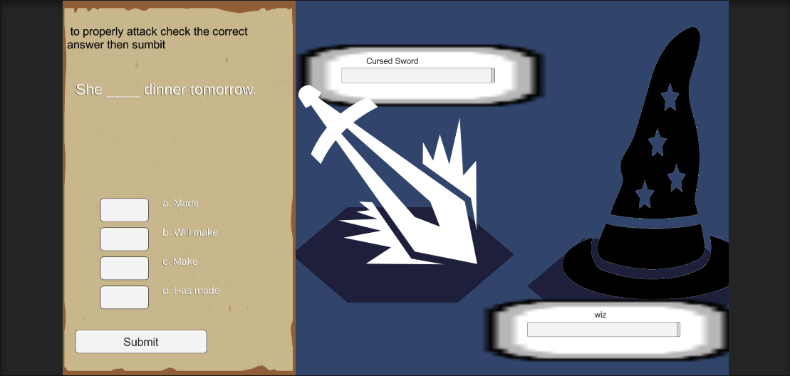
User selects English Dungeon and clicks level 1

Slide 13
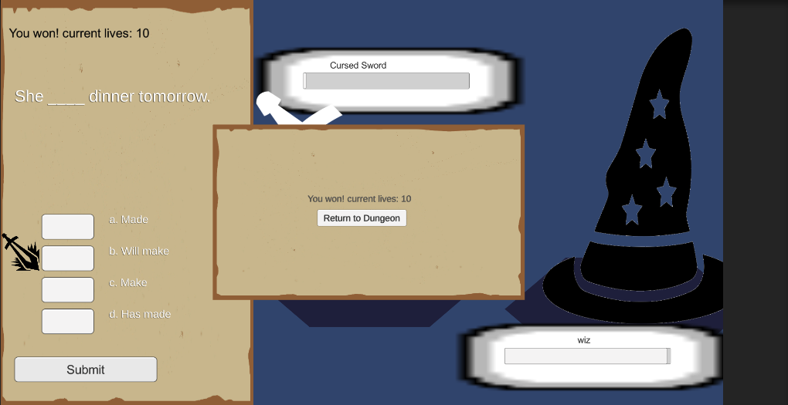
User answers correctly

Slide 14
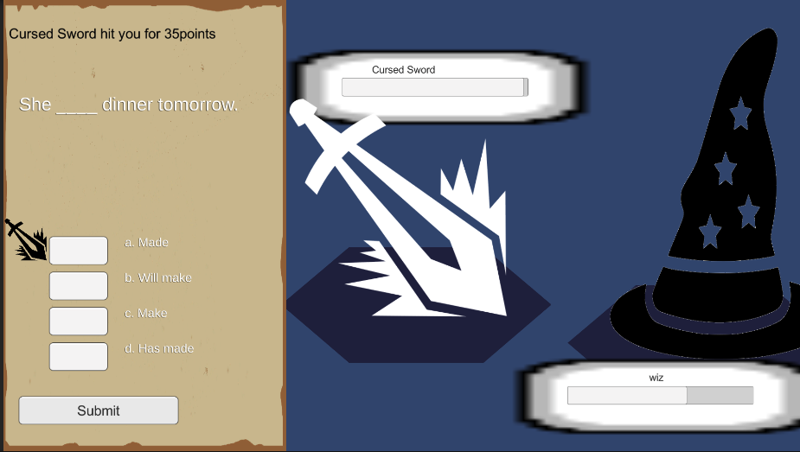
User answers incorrectly

Slide 15
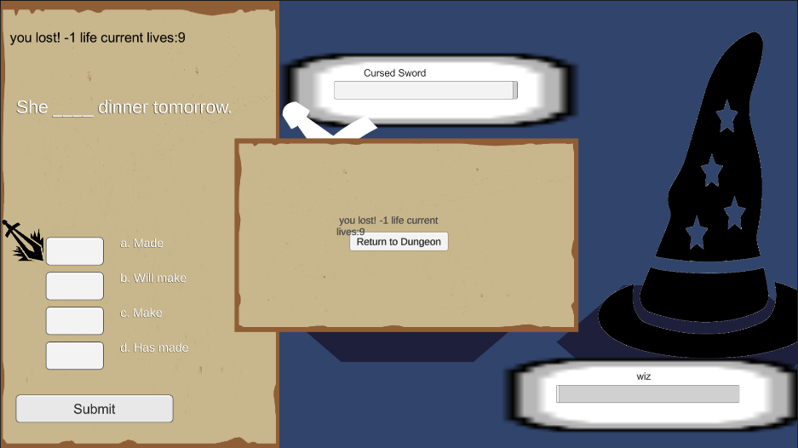
User answers incorrectly 3 times

Slide 16
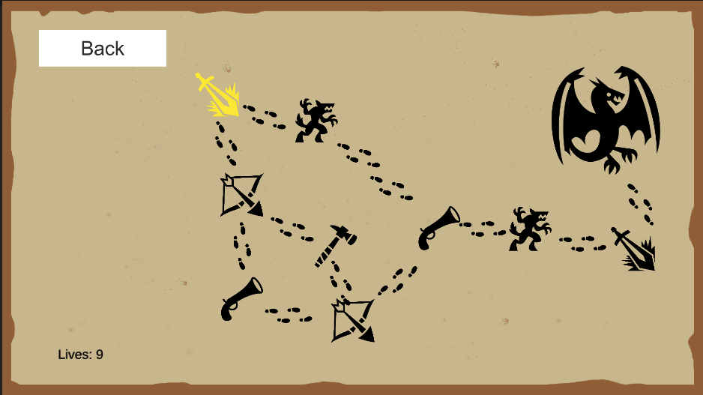
Lost life is reflected on map after losing encounter

Slide 17
The user continues to answer questions correctly
Notes:
Wyatt

Slide 18
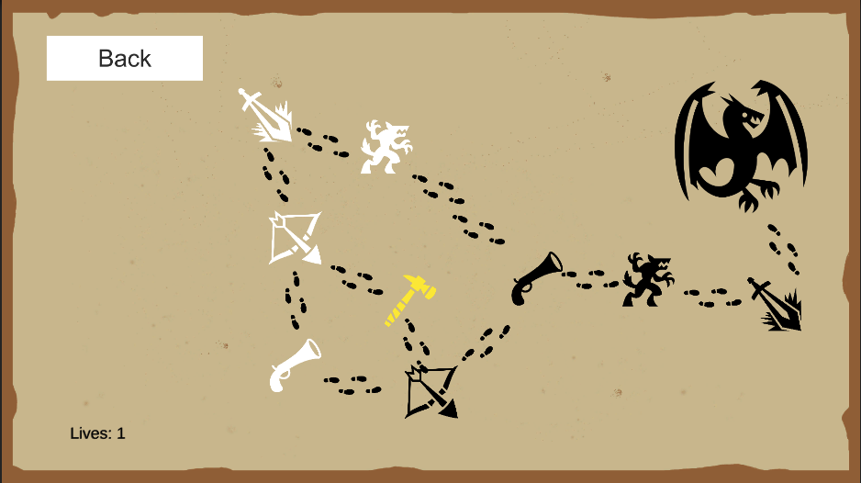
Losing all lives resets all progress

Slide 19
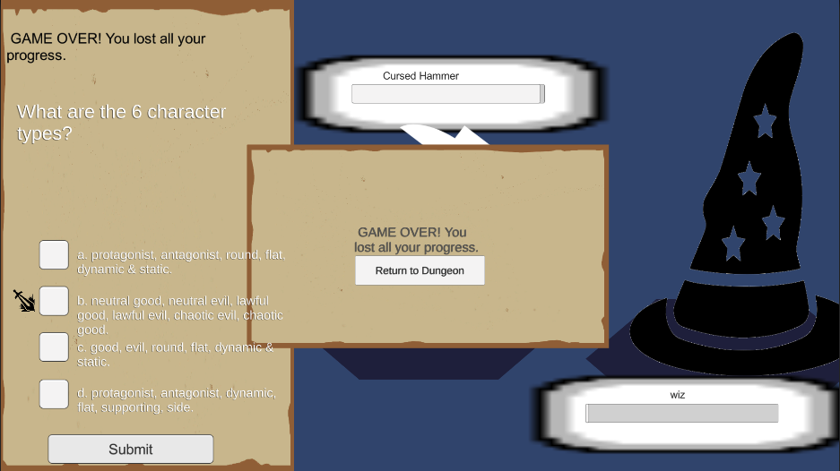
Losing all lives resets all progress

Slide 20

Losing all lives resets all progress

Slide 21
Future additions
A more detailed scoring system.
Currently score is based on encounters successfully completed.
Goal would be to base it on correct answers vs incorrect, time to answer, etc.
Allow users to create accounts.
Store scores from different playthroughs to view improvement.
Let educators implement their own questions.
Ensures questions coincide with their lessons.
Allow them to see and track their students scores.
Notes:
Nick

Slide 22
Future Additions pt. 2
More complex encounters
Attack vs Defense questions
Multiple questions per encounter.
Different attacks, status moves, etc.
Varying/Random dungeon maps
Builds for other platforms
MacOS, Linux, mobile
Notes:
Nick

Slide 23
Citations
1. Gamification – incentivizing students for an engaged classroom. Virtucom. (2019, August 28). Retrieved December 5, 2021, from https://virtucom.com/gamification-incentivizing-students-engaged- classroom/.
2. D. Thakore and S. Biswas, “Routing with Persistent Link Modeling in Intermittently Connected Wireless Networks,” Proceedings of IEEE Military Communication, Atlantic City, October 2005.
3. G. Kaplowitz, N. Miceli, D. Lor, W. LaRose, A. Chavez, “Dungeon Quest” (2021). https://derricklor.github.io/SWEProject/Website/index.html
4. H. Nguyen, “How to Use Gameplay to Enhance Classroom Learning,” Edutopia.org, March 2021.
5. Massachusetts Department of Elementary and Secondary Education. (2017). “Massachusetts Mathematics Curriculum Framework — 2017”. https://www.doe.mass.edu/frameworks/math/2017-06.pdf
6. Squire, Kurt. "Video games in education." Int. J. Intell. Games & Simulation 2.1 (2003): 49- 62. http://citeseerx.ist.psu.edu/viewdoc/download?doi=10.1.1.543.5729&rep=rep1&type=p df

Slide 24
Acknowledgements
We gratefully acknowledge and appreciate the participation of Dr. James Daly and the students of this class for their timely feedback

